Slide 1
VMware Tanzu GemFire VMware Tanzu Application Service
Install and Tanzu GemFire demo
Charlie Black
Tanzu GemFire Product Manager

Slide 2
Short recap of What is Tanzu GemFire and Tanzu Application Service for Kubernetes
Overview of installation
Time-lapse install
Complete a Node Application with Tanzu GemFire
CF PUSH
Test Drive the Node Application

Slide 3

Tanzu GemFire for Kubernetes
High-performance key-value database for modern cloud native applications
Visit https://tanzu.vmware.com/gemfire to learn more

Slide 4
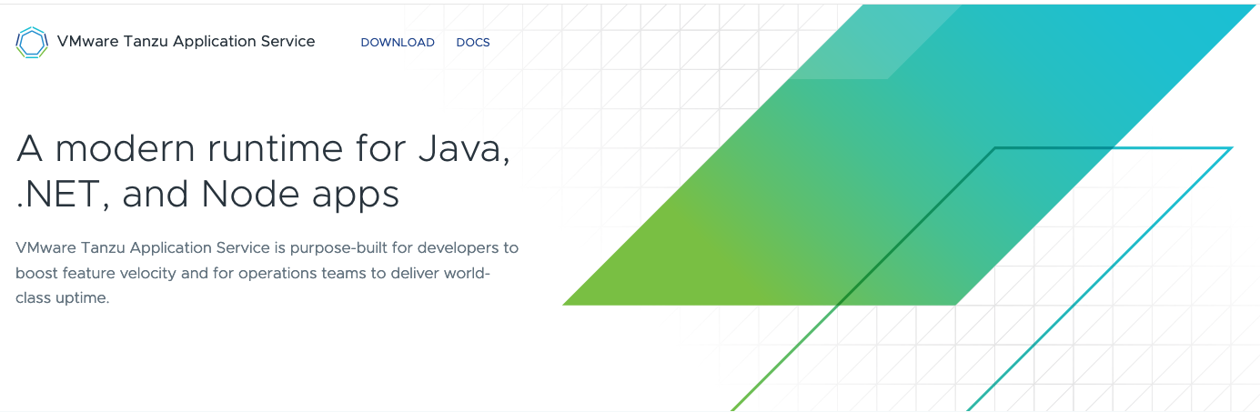
Tanzu Application Service for Kubernetes
Here is my code, run it in the cloud, I don't care how
cf push
Visit https://tanzu.vmware.com/application-service to learn more

